Slide 1
Sentimental Analysis of Employee Review
Presenter: Group 17
Notes:
You can add a nice Project name

Slide 2
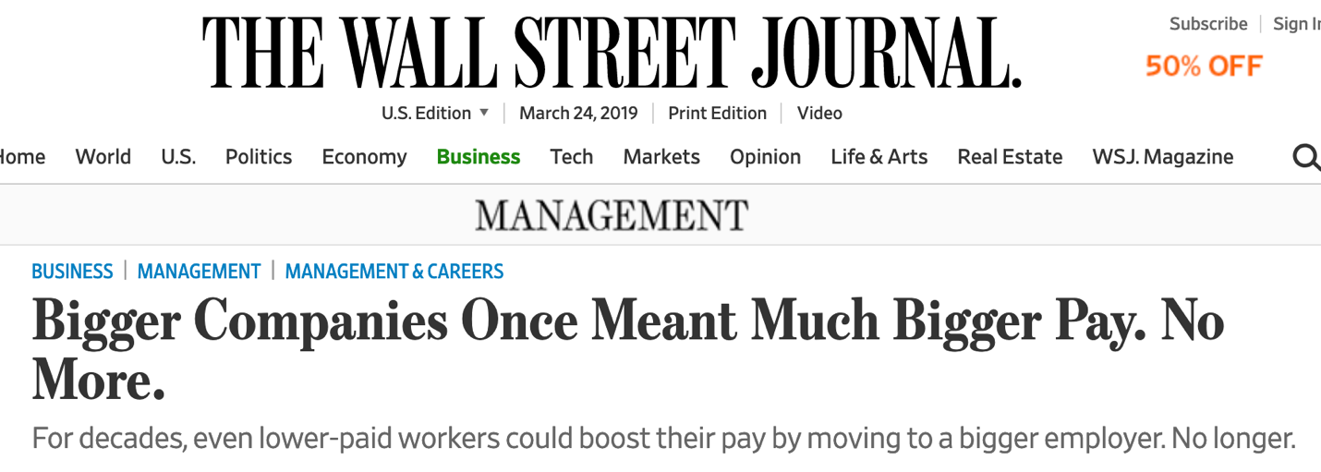

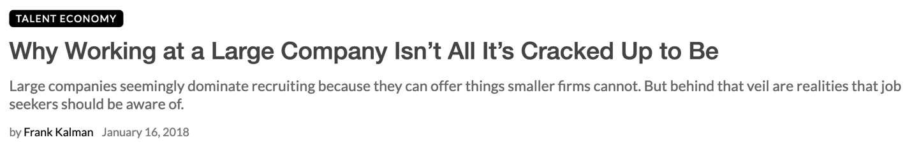

Slide 3
Why this Analysis is required?
Why employees from big companies like Google, Amazon, etc. are refraining from working there.
What are the factors affecting it?
What is the solution?

Slide 4
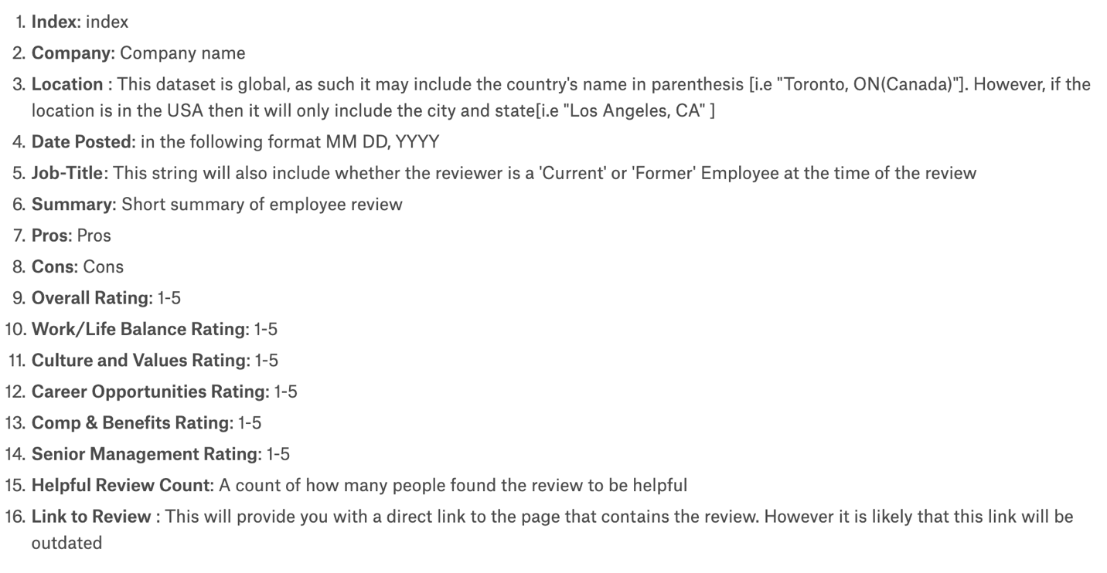
Data Set
67K rows and 17 columns
Variables:

Slide 5
Models and Analysis
Random Forest :-
The main reason why we are using Random forest is that it builds multiple decision trees and merges them to get a more accurate and stable prediction.
For example, we take a negative word as Politics (from our dataset) then we will see what are the other factors.
One big advantage of random forest is, that it can be used for both classification and regression problems, which form most current machine learning systems.

Slide 6
Models and Analysis
K- Nearest Neighbors :-
In KNN data points are separated into several classes or clusters to predict the classification of a new sample point.
Similarly, if we want to predict whether the current employee will leave the organization or not based on the existing reviews, rating and other such feature which are termed into one cluster by KNN.
As it is a non-parametric algorithm, it means that it does not make any assumptions on the underlying data distribution which helps in the real world as we should avoid making any assumptions so that our model is unbiased.

Slide 7
Models and Analysis
NLP Techniques :-
The dataset also contains two columns named as pros and cons which are user feedback on the company.
We would be using NLP models to pick the words that most users have liked or disliked about the company using a bag of words or other relevant technique from NLTK Sentiment Analysis package.
Example1:- 1 user has commented in pros that they like the new food and café system
Example2:- The other comment in cons that the work/life balance is not good and the managers are not helpful, etc.
Using keywords like “New Cafeteria System”, “Work/life balance”, etc. the company can do some changes in their way of working so that they can improve this factor.

Slide 8
Expected Insights
This dataset can be useful for both, The Organization and the User.
From Organizational Point of View :-
Predicting what are the chances that the current employee will either stay/leave the organisation.
To improve the organisation’s working culture or work-life balance, such reviews and the results will help them to spot a place for improvement.
Employee Feedback are important for the organisation.
From User Point of View :-
It can help the new joiner to decide whether is it the right place to start their career with.

Slide 9
THANK YOU

